Slide 1
Introducing Containers & Kubernetes What’s all the hype?!

Slide 2
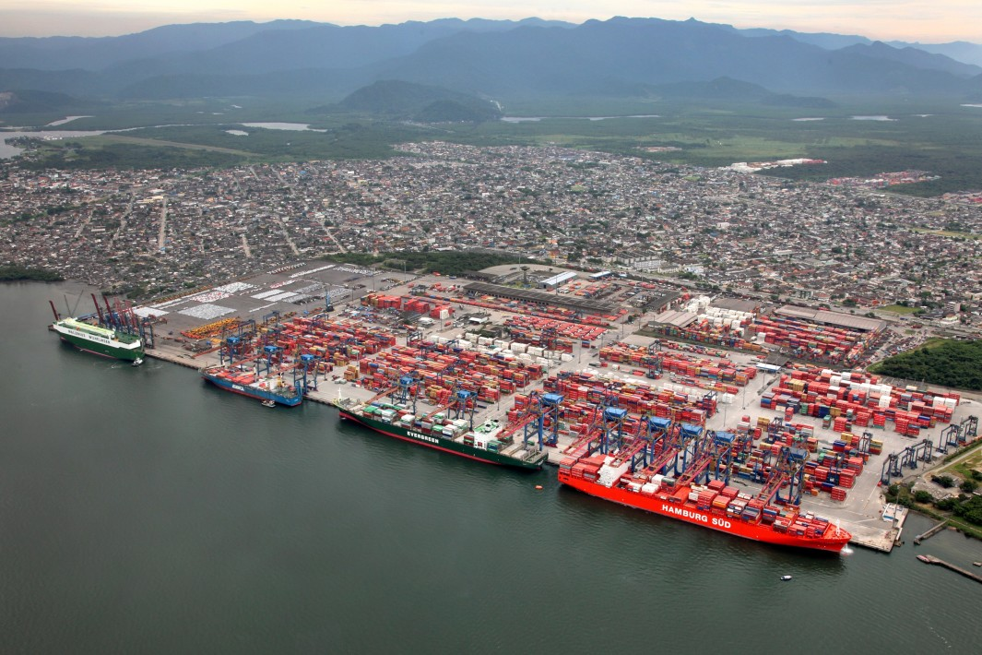
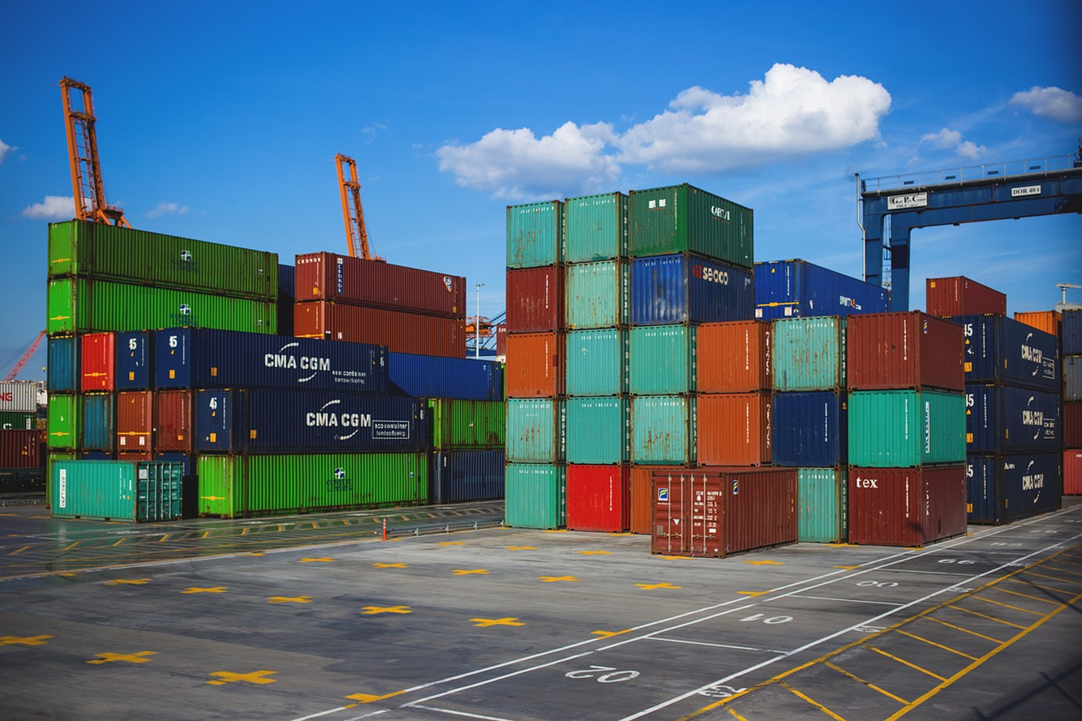
Review: What is a Container?
Containers are an application-centric way to deliver high-performing, scalable applications on the infrastructure of your choice.

Slide 3
What is a Container?
VM
VM
VM
VM
App A
App B
App C
Guest OS
Guest OS
Guest OS
Guest OS
Hypervisor
Hypervisor
Host OS
Host OS
Server
Server

Slide 4
What is a Container?
VM
VM
VM
VM
App A
App B
App C
Guest OS
Guest OS
Guest OS
Container Engine
Guest OS
Hypervisor
Hypervisor
Host OS
Host OS
Server
Server

Slide 5
What is a Container?
VM
VM
VM
VM
App A
App B
App C
Container
App A
Guest OS
Guest OS
Guest OS
Bins/Libs
Container Engine
Guest OS
Hypervisor
Hypervisor
Host OS
Host OS
Server
Server

Slide 6
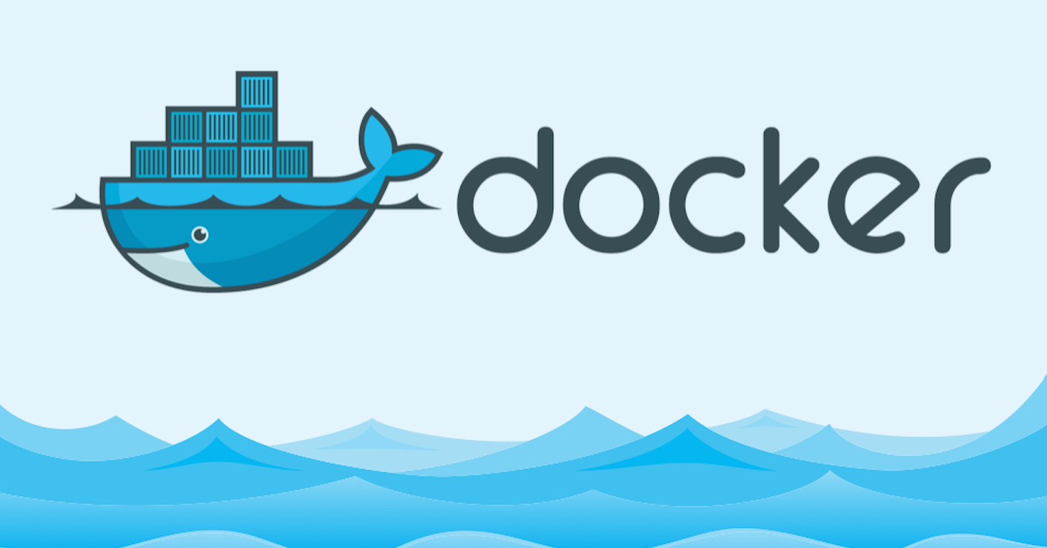
What is a Container?
VM
VM
VM
VM
App A
App A
App B
Container
Container
Container
App A
App B
App C
Guest OS
Guest OS
Guest OS
Bins/Libs
Bins/Libs
Bins/Libs
Container Engine
Guest OS
Hypervisor
Hypervisor
Host OS
Host OS
Server
Server

Slide 7
What is a Container Registry?
Discover your containers
A place to store, list, and share your container images
Like an “app store” for container images
DockerHub is a registry hosted by Docker. Many companies publish their containers there.
Most cloud providers offer their own Cloud Registries “as-a-service”
Azure has the… “Azure Container Registry”!
Docker tools can publish to a container registry
Docker can run a container image from a registry

Slide 8
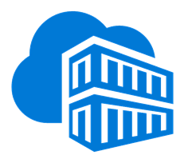
What is a Container Registry?
VM
Container
Container
Container
Container Registry
Azure Container Registry
hub
App A
App B
App C
Container Image
Container Image
Bins/Libs
Bins/Libs
Bins/Libs
Container Image
Container Engine
Container Image
Guest OS
Container Image
Hypervisor
Container Image
Host OS
Server

Slide 9

Docker Lab
Notes:
Show Docker images on the machine
Show Docker images running on the machine
Quick demo a Dockerfile?

Slide 10
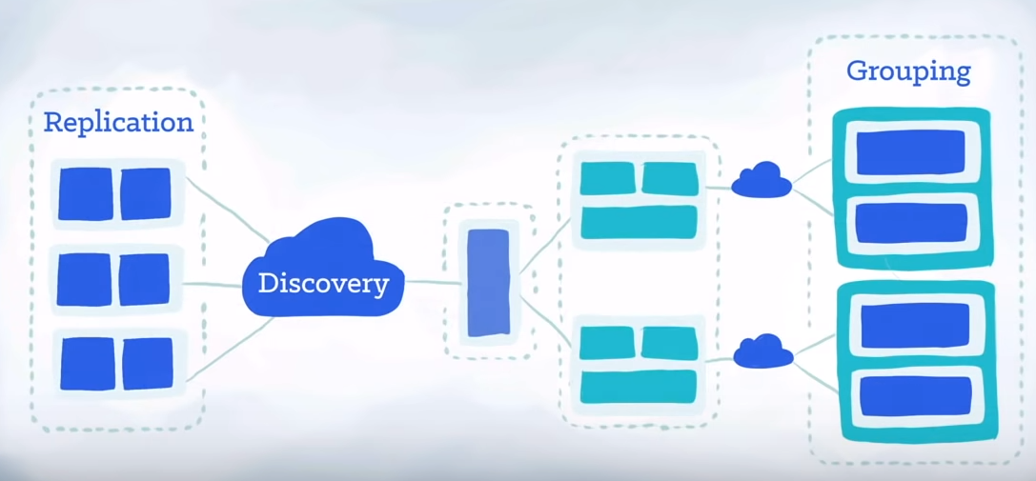
A short k8s video
https://www.youtube.com/watch?v=4ht22ReBjno

Slide 11
Ok, I’ve got containers.
And a registry.
Now what?

Slide 12
I’m going to want more VMs with containers!
VM
VM
Container
Container
Container
Container
Container
Container
App A
App B
App C
App A
App B
App C
Bins/Libs
Bins/Libs
Bins/Libs
Bins/Libs
Bins/Libs
Bins/Libs
Container Engine
Container Engine
Guest OS
Guest OS
Hypervisor
Hypervisor
Host OS
Host OS
Server
Server

Slide 13
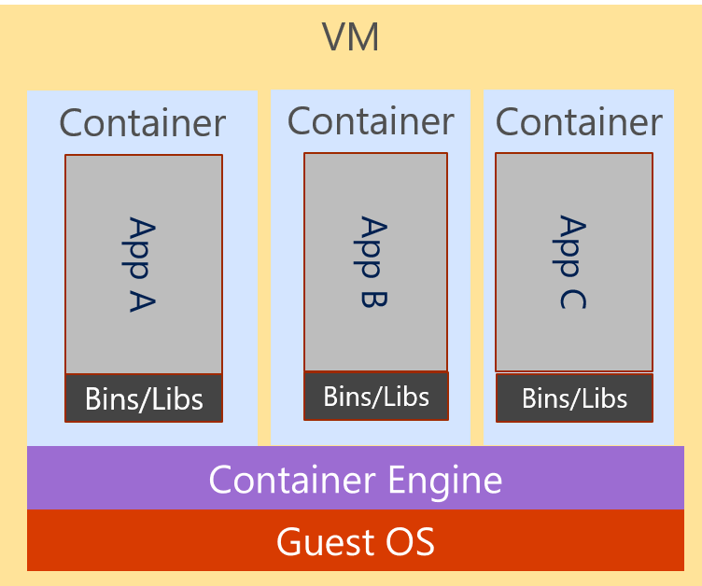
And more… and more!

Slide 14
And more… and more… CHAOS!!!

Slide 15
What is a Container Orchestrator?
Container orchestrators group hosts together to form a cluster, and fulfill these requirements:
Are fault tolerant
Can scale on demand
Use resource optimally
Discover other applications automatically
Accessible from the external world
Updates and roll-backs without downtime

Slide 16
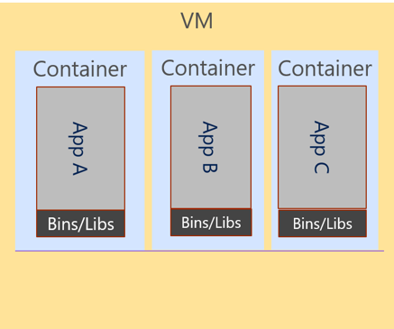
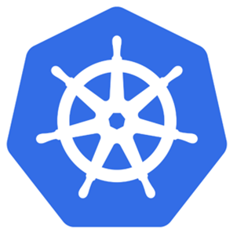
Kubernetes is a Container Orchestrator!
Cluster
VM
Kubernetes
Guest OS
Hypervisor
Host OS
Server

Slide 17
The elements of orchestration
Scheduling
Affinity/anti-affinity
Health monitoring
Failover
Scaling
Networking
Service discovery
Coordinated app upgrades

Slide 18
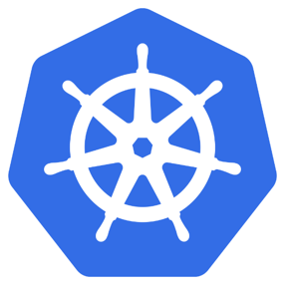
What is Kubernetes?
"Kubernetes is an open-source system for automating deployment, scaling, and management of containerized applications."
Kubernetes comes from the Greek word κυβερνήτης:, which means helmsman or ship pilot, ie: the captainer of a container ship.

Slide 19
Kubernetes has a Master & Cluster of “Nodes”
Cluster
VM
Master Node
Kubernetes
Node
Node
Node
Node
Node
Node
Guest OS
Hypervisor
Host OS
Server

Slide 20
Azure Kubernetes Service (AKS)
AKS reduces the complexity and operational overhead of managing Kubernetes by offloading much of that responsibility to Azure.
You only pay for the agent nodes within your clusters, not for the master nodes

Slide 21
AKS is Kubernetes (Master) as a Service
Cluster
Kubernetes
Master
Node
Node
Node
Node
Node
Node

Slide 22
Kubernetes Fundamentals Pods, Deployments, & Services, Oh my!

Slide 23
Kubernetes @ 10,000ft
Cluster
Kubernetes
Master
Node
Node
Node
Node
Node
Node

Slide 24
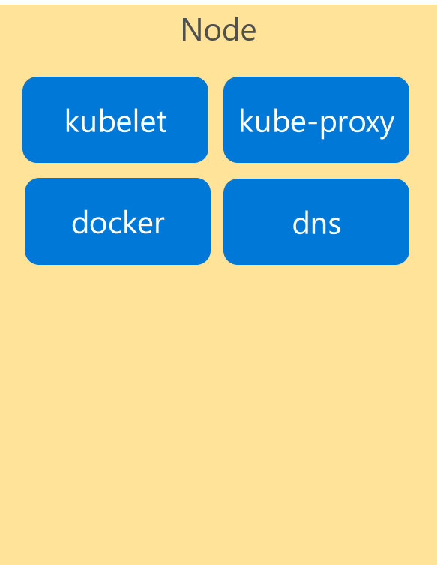
Kubernetes Architecture Components
Cluster
Master
Node
api-server
kubelet
kube-proxy
controller-manager
docker
dns
etcd
scheduler
*Azure Managed
Notes:
If we look inside the VM nodes in a Kubernetes clusters, we’ll see a whole set of services that are running on each.
These are containers themselves!
These services are how Kubernetes handles management of the nodes and things that run on them.
I’m going explain these now briefly…

Slide 25
Kubernetes Architecture Components
Introducing…. Pods!
Pod
Pod
Pod
Container
Container
Container
App A
App B
App C
Bins/Libs
Bins/Libs
Bins/Libs
Containers go inside Pods!

Slide 26
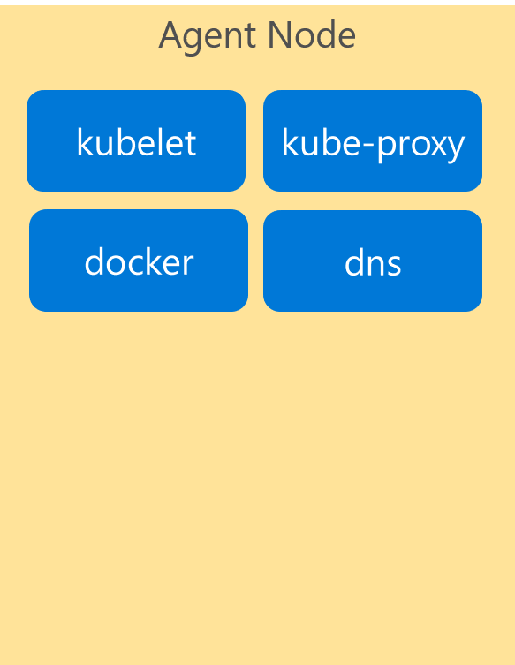
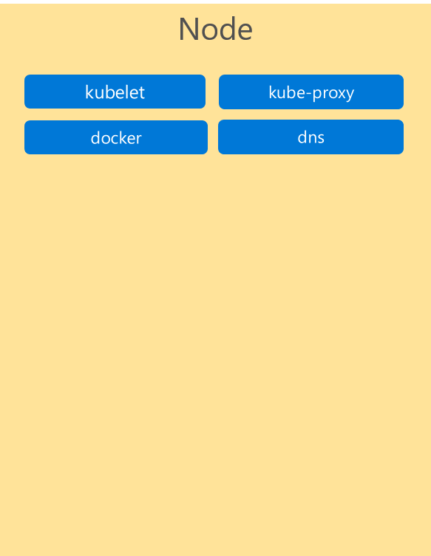
Kubernetes Architecture Components
Pods
Cluster
Master
Node
Kube stuff
Kube stuff
api-server
kubelet
kube-proxy
docker
dns
Pod
App A
Pod
App B
Pod
App D
controller-manager
Pod
App A
Pod
App B
Pod
App C
etcd
scheduler
Pod
App C
Pod
App C
*Azure Managed
Notes:
Here are some pods running across multiple nodes on our cluster…

Slide 27
Pods
pod
pod
ratings-api
ratings-web
port
3000
port
8080
pod
ratings-db
port
27017
Notes:
Add image name

Slide 28
Deployment
label
app=ratings-web , tier=web
image
azurecr.io/ratings-web:v1
pod
ratings-web-1
port
8080
pod
ratings-web-2
port
8080
ratings-web
Notes:
Add replicas

Slide 29
Kubernetes Architecture Components
Cluster
Master
Node
Node
Kube stuff
Kube stuff
Kube stuff
api-server
kubelet
kube-proxy
kubelet
kube-proxy
docker
dns
docker
dns
controller-manager
Pod
ratings-web1
Pod
ratings-web2
etcd
scheduler
*Azure Managed
Notes:
Here is what that deployment might look like when it’s deployed to our cluster

Slide 30
Deployment
label
app=ratings-web, tier=web
image
azurecr.io/ratings-web:v1
pod
Service
ratings-web-1
port
8080
ratings-web
pod
port
selector
app=ratings-web
ratings-web-2
port
8080:8080
port
8080
IP
10.0.2.20
ratings-web

Slide 31
Kubernetes Architecture Components
Pods
Cluster
Master
Node
Node
Kube stuff
Kube stuff
Kube stuff
api-server
kubelet
kube-proxy
kubelet
kube-proxy
docker
dns
docker
dns
controller-manager
Service
ratings-web
IP Address
Pod
ratings-web1
Pod
ratings-web2
etcd
scheduler
*Azure Managed
Notes:
Here’s how a service might be represented in our cluster.
It’s abstract grouping of the pods running ratings-web with its own endpoint which can be used to load balance across the pods

Slide 32
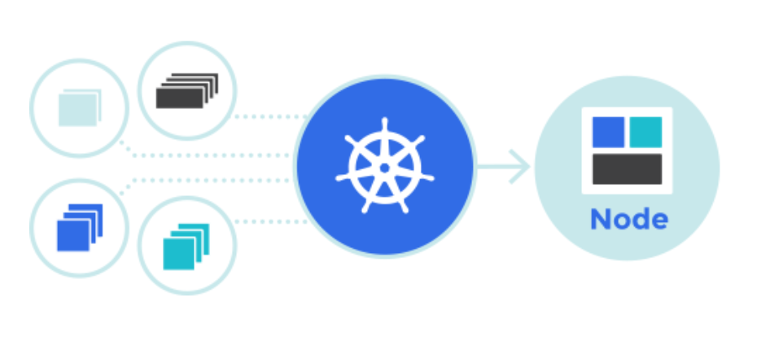
Kubernetes Lab
Notes:
Show Docker images on the machine
Show Docker images running on the machine
Quick demo a Dockerfile?

Slide 33
Kubernetes Architecture Components
Pods
Cluster
Master
Node
Node
Kube stuff
Kube stuff
Kube stuff
api-server
kubelet
kube-proxy
kubelet
kube-proxy
docker
dns
docker
dns
controller-manager
Service
ratings-web
IP Address
Pod
ratings-web1
Pod
ratings-web2
etcd
scheduler
Pod
ratings-api1
Pod
ratings-db1
Pod
someotherpod
*Azure Managed
Notes:
And here’s an example of other pods just running outside of the service

Slide 34
apiVersion: apps/
Kind: deployment
Metadata:
name: rating-web
apiVersion: apps/
Kind: deployment
Metadata:
name: rating-web
apiVersion: apps/
Kind: deployment
Metadata:
name: rating-web
customResorce
micro-web
api-server
port
8000
deployment
service
ingress
rating-web
rating-web
rating-web
port
8080
port
8080
port
8080
pod
pod
rating-web
rating-web
port
8080
port
8080

Slide 35
Operationalizing K8S Monitoring and Logging

Slide 36
Monitoring
Kubernetes monitoring provides us with the ability to view what is happening within the cluster nodes, pods and containers.
Benefits:
View application logs.
Identify resource bottlenecks.
View the cluster's overall performance.
Review the resource utilization of workloads running on the host that are unrelated to the standard processes that support the pod.
Understand the behavior of the cluster under average and heaviest loads.
Identify capacity needs and determine the maximum load that the cluster can sustain.

Slide 37
Logging and Troubleshooting
Viewing full logs for pods and services:
kubectl logs
There are various ways to troubleshoot:
Finding out why pods are failing:
kubectl describe pod
Getting a bash shell into a running container in a pod:
kubectl exec

Slide 38
Application Health and Readiness
Kubelets on workers use liveness and readiness probes to know when to restart a container or start directing traffic
Liveness check: when to restart
Readiness check: when to forward Service traffic to a pod
Notes:
Look at liveness
Look at readiness

Slide 39
Monitoring: What indicators matter in Kubernetes
Cluster health: total number of nodes, pods, etc
Node health: available compute resources, health
Application health
Tooling Examples
Datadog
Prometheus
InfluxData
Cloud-specific: Azure Monitor, AWS CloudWatch
Notes:
https://docs.datadoghq.com/integrations/kubernetes/

Slide 40
Logging
Pod logs: applications must log to standard out!
Cluster-wide event logs
Logging forwarder solutions
fluentd
logstash
Log indexers
OMS Log Analytics
Splunk
ELK stack

Slide 41
Kubernetes Scaling & HA

Slide 42
Application Scaling Strategies
Application Level
Increase/decrease the number of pods for a given service
Handled by the orchestrator or the application itself
Kubernetes Horizontal Pod Autoscaling
Infrastructure Level
Increase/decrease the number of VM’s running in the cluster
Azure infrastructure function
via AKS API/CLI (utilizes Azure VM Scale Sets)
Auto-scaling coming to AKS soon
These functions should be coordinated

Slide 43

Scaling Pods
Pod
Pod
Pod
Pod
Pod
Pod

Slide 44
Scaling Nodes
Pod
Pod
Pod
Pod
Pod
Pod
Pod
Pod

Slide 45
Scaling the AKS Cluster

Slide 46
Kubernetes Updates & Rollbacks

Slide 47
Rolling Updates and Roll-Backs
Incremental update of a deployment (ie: set of pods).
Service will load balance between the old and the new until the old versions are all terminated.
Similar to scaling.
All updates are versioned and can be rolled back.
Roll backs use the same mechanism to deploy the new pods.

Slide 48
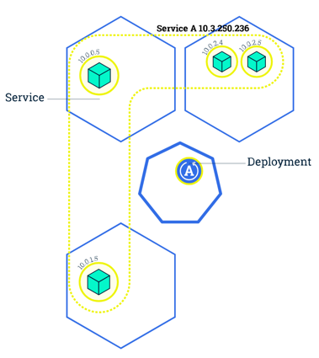
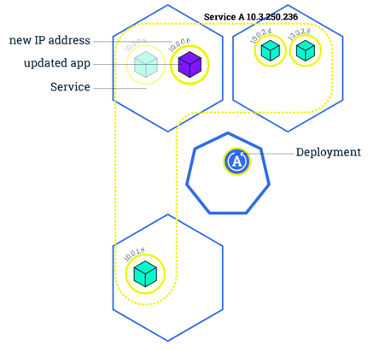
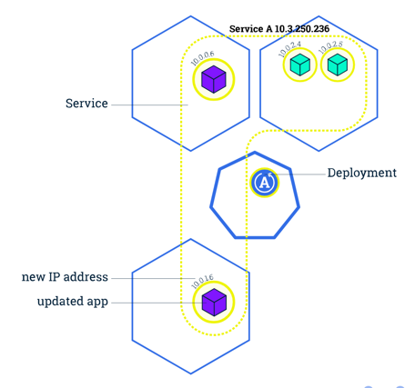
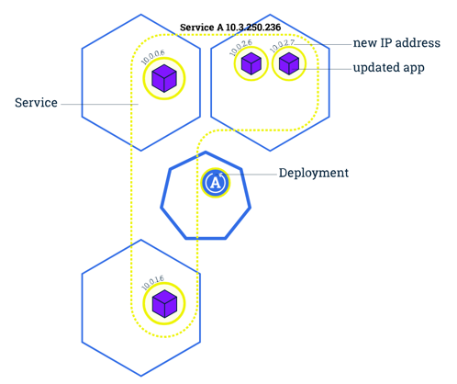
Rolling Updates and Roll-Backs

Slide 49
Rolling Updates and Roll-Backs

Slide 50
Blue/Green Deployments
Some applications can not handle rolling updates
Shared state, API schema changes, etc.
In these cases a Blue/Green deployment is needed
Similar to Azure’s concept of Deployment Slots
New deployment creates all Pod replicas with a new label.
When finished, we update the Service to point to the new label.

Slide 51
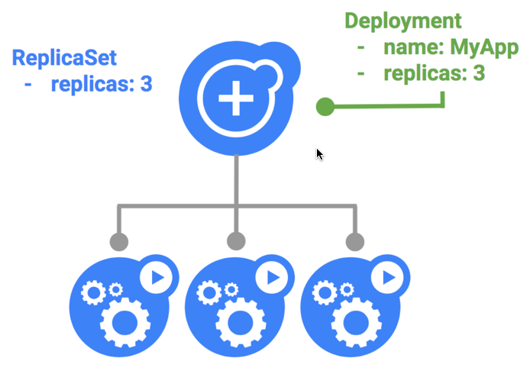
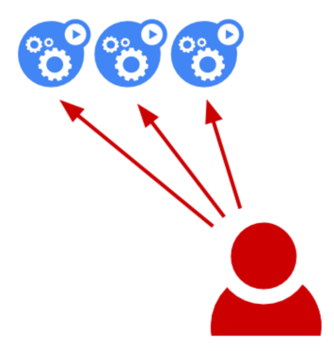
Blue – The Initial Deployment

Slide 52
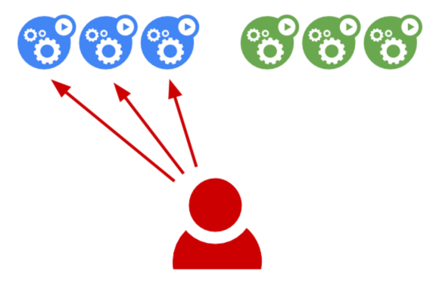
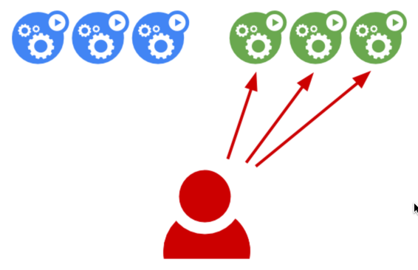
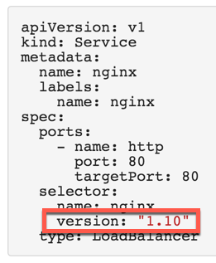
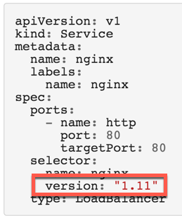
Green – The New Deployment

Slide 53
Kubernetes - Storage

Slide 54
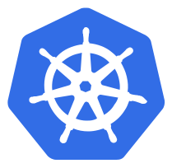


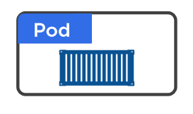
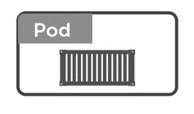
Volumes in Kubernetes
Why we need to volumes ?
On-disk files in a Container
are
ephemeral
Volume
(state)

Slide 55
Volumes in Kubernetes
Different Types
Volumes
emptyDir
hostPath
Cloud Volumes
Persisted Volum Claim (PVC)
ConfigMap
Security
….
RAM
HDD /SSD

Slide 56
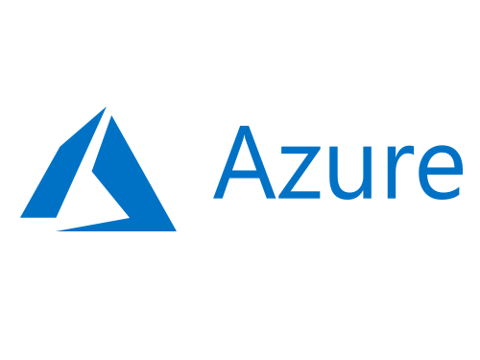

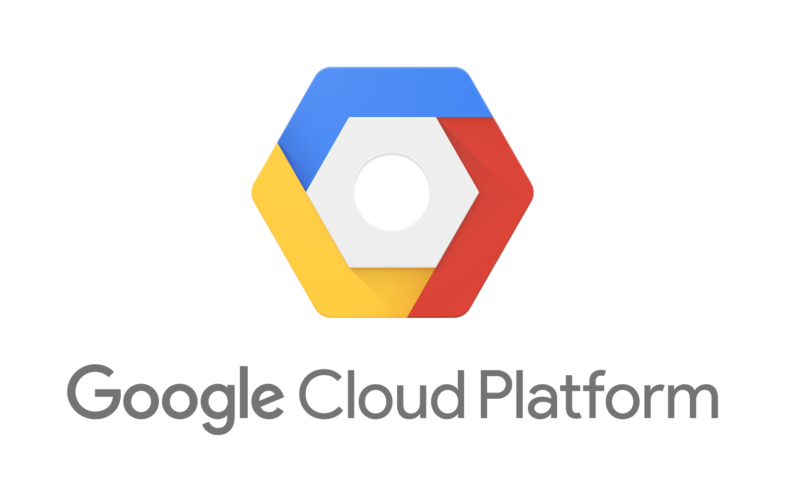
Volumes in Kubernetes
Different Types of Volumes
Volumes
emptyDir
hostPath
Cloud Volumes
Persisted Volum Claim (PVC)
ConfigMap
Security
….

Slide 57



Volumes in Kubernetes
PV vs PVC
Volumes
emptyDir
hostPath
Cloud Volumes
Persisted Volum Claim (PVC)
ConfigMap
Security
….
Cluster Admin
Persisted Volume
(static)
Developer
Storage Class
(dynamic)

Slide 58
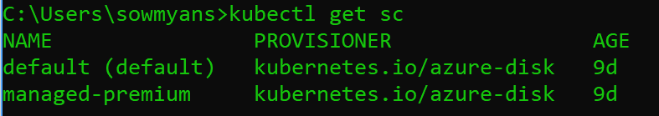
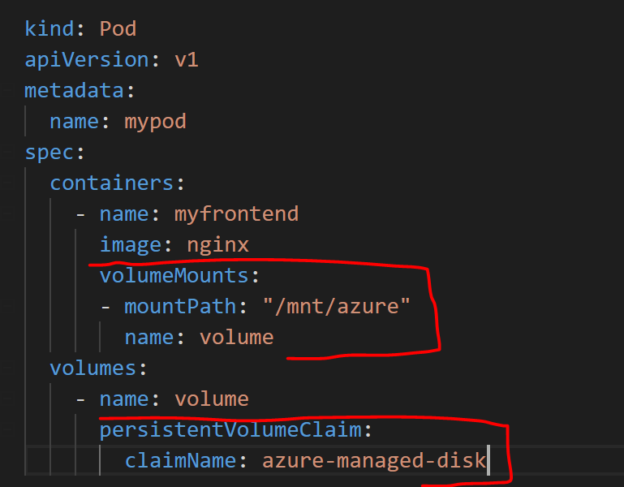
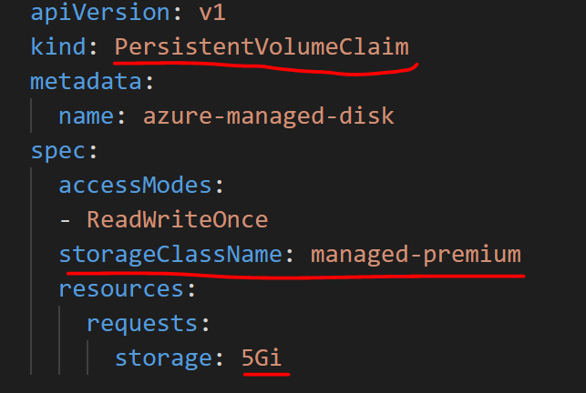
Volumes in Kubernetes
Dynamic Storage in AKS – Azure Disk

Slide 59

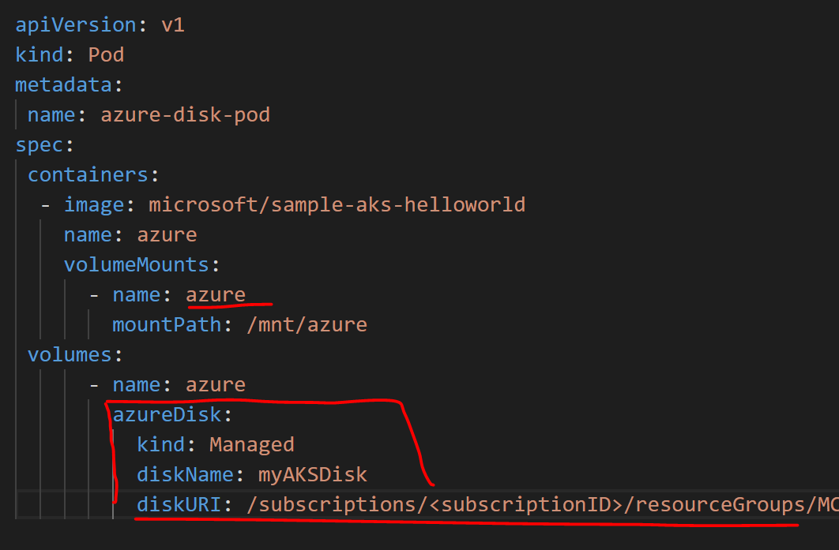
Volumes in Kubernetes
Static Storage in AKS – Azure Disk
az disk create \ --resource-group MC_myResourceGroup_myAKSCluster_eastus \ --name myAKSDisk \ --size-gb 20 \ --query id --output tsv
/subscriptions/<subscriptionID>/resourceGroups/MC_myAKSCluster_myAKSCluster_eastus/providers/Microsoft.Compute/disks/myAKSDisk

Slide 60
Kubernetes - Networking

Slide 61
Networking in Kubernetes
Kubernetes Networking model introduces 3 methods of communications:
Pod-to-Pod communication directly by IP address. Kubernetes has a Pod-IP wide metric simplifying communication.
Pod-to-Service Communication – Client traffic is directed to service virtual IP by iptables rules that are modified by the kube-proxy process (running on all hosts) and directed to the correct Pod.
External-to-Internal Communication – external access is captured by an external load balancer which targets nodes in a cluster. The Pod-to-Service flow stays the same.
Notes:
When the backend Service is created, the Kubernetes master assigns a virtual IP address, for example 10.0.0.1. Assuming the Service port is 1234, the Service is observed by all of the kube-proxy instances in the cluster. When a proxy sees a new Service, it installs a series of iptables rules which redirect from the VIP to per-Service rules. The per-Service rules link to per-Endpoint rules which redirect (Destination NAT) to the backends.
When a client connects to the VIP the iptables rule kicks in. A backend is chosen (either based on session affinity or randomly) and packets are redirected to the backend. Unlike the userspace proxy, packets are never copied to userspace, the kube-proxy does not have to be running for the VIP to work, and the client IP is not altered.
This same basic flow executes when traffic comes in through a node-port or through a load-balancer, though in those cases the client IP does get altered.

Slide 62
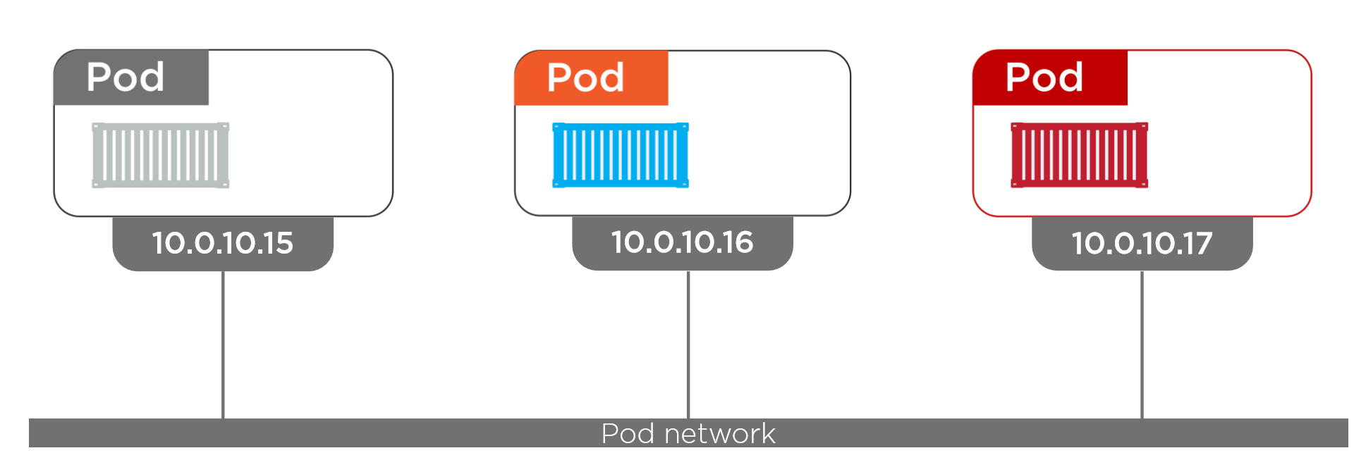
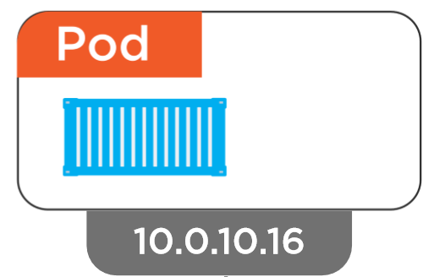
Networking – Pod
Inter-Pod Communication
Notes:
Pods are the unit of deployment in k8s
Each pod get an IP address and each pods can communicate each other in the Pod Network provided by K8s regardless of nodes

Slide 63
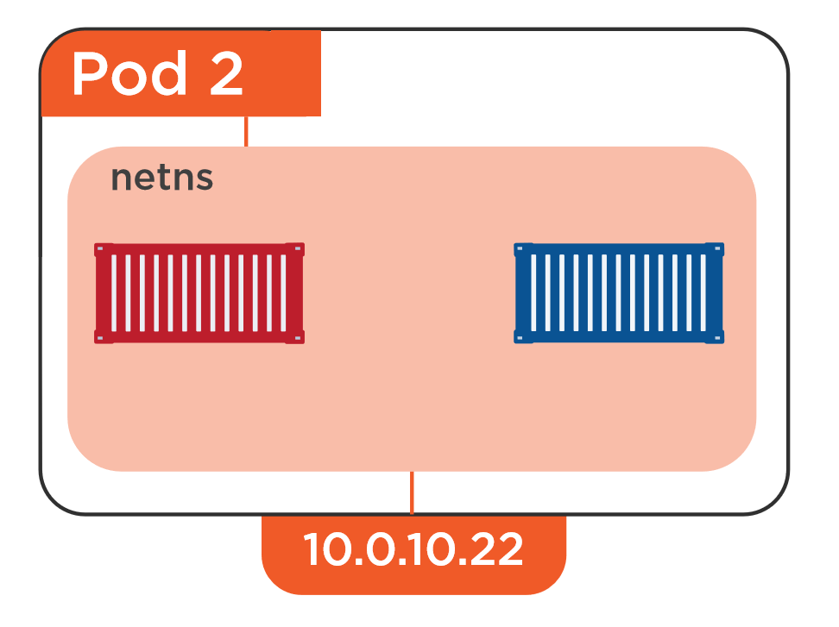
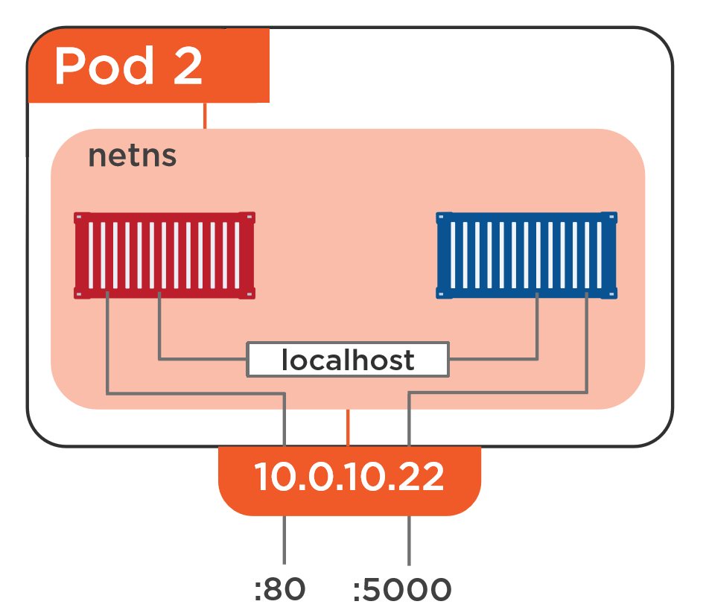
Networking - Pod
Inter-Pod Communication
Notes:
There can be one or more containers in a single pod
By default each container can communicate with other via localhost with port number
If we need to access a specific app in a one of those container then can use the Pod IP : Port number

Slide 64
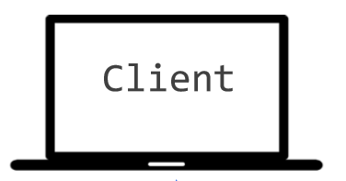

Networking - Service
Why Service ?
10.0.10.1
10.0.10.2
10.0.10.3
10.0.10.10
10.0.10.4

Slide 65
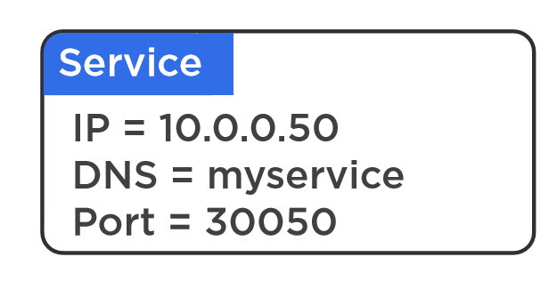
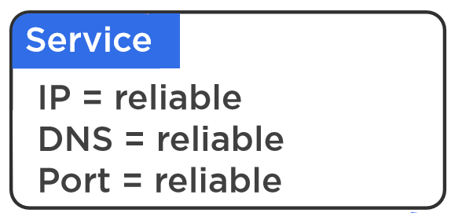
Networking – Service
Why Service ?
10.0.10.1
10.0.10.2
10.0.10.3
10.0.10.4

Slide 66
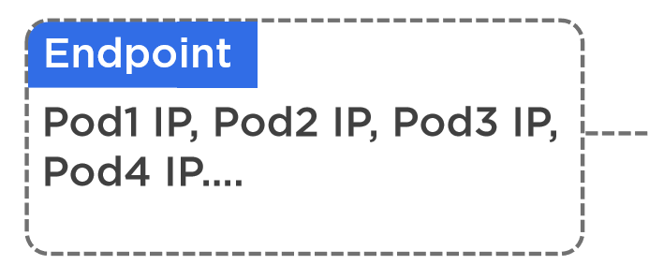
Networking - Service
How does Service Works
Name : Foo
Type : API
10.0.10.1
10.0.10.1
10.0.10.1
10.0.10.1
10.0.10.1
10.0.10.1
Name : Foo
Name : Foo
Name : Foo
Name : Foo
Name : Bar
Name : Bar
Type : API
Type : API
Type : API
Type : API
Type : Database
Type : Database

Slide 67
Different Type of Services
ClusterIP (default)
NodePort
LoadBalancer

Slide 68
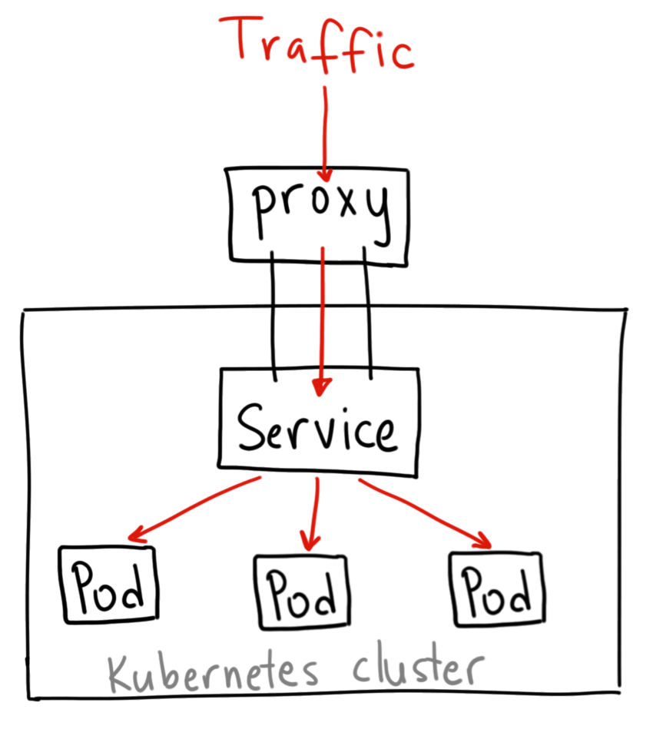
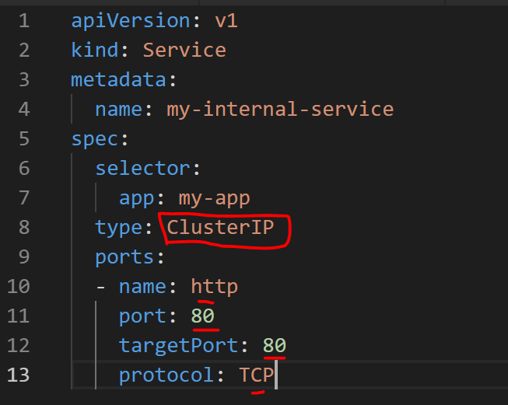
Networking – Service : ClusterIP
How does ClusterIP Service Works
Notes:
A ClusterIP service is the default Kubernetes service. It gives you a service inside your cluster that other apps inside your cluster can access. There is no external acces
When would you use this?
There are a few scenarios where you would use the Kubernetes proxy to access your services.
Grouping pods into subset of services, e.g all Foo API pods , Foo database pods, Foo Web Front Pods etc..
Debugging your services, or connecting to them directly from your laptop for some reason
Allowing internal traffic, displaying internal dashboards, etc.

Slide 69
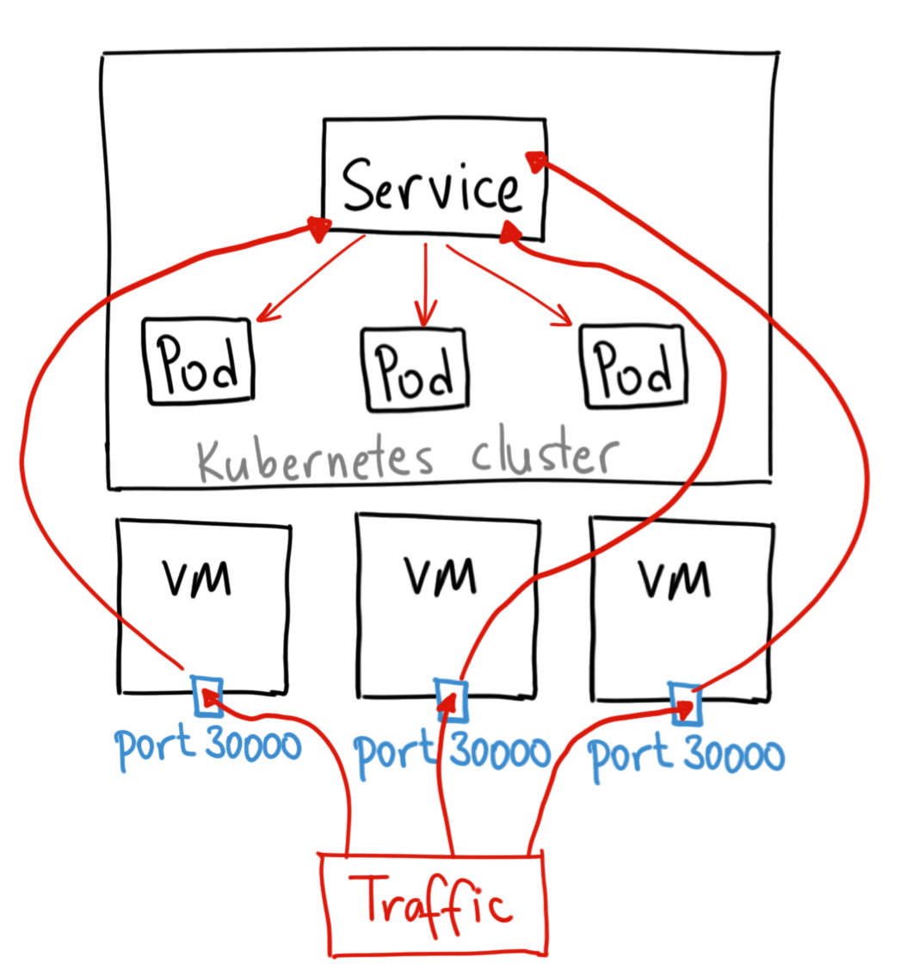
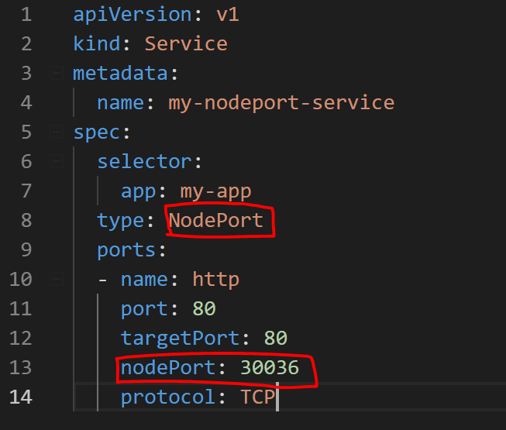
Networking – Service : NodePort
How does NodePort Service Works
Notes:
A NodePort service is the most primitive way to get external traffic directly to your service. NodePort, as the name implies, opens a specific port on all the Nodes (the VMs), and any traffic that is sent to this port is forwarded to the service.
Basically, a NodePort service has two difference from a normal “ClusterIP” service. First, the type is “NodePort.” There is also an additional port called the nodePort that specifies which port to open on the nodes. If you don’t specify this port, it will pick a random port. Most of the time you should let Kubernetes choose the port;
There are many downsides to this method:
You can only have once service per port
You can only use ports 30000–32767
If your Node/VM IP address change, you need to deal with that
For these reasons, I don’t recommend using this method in production to directly expose your service. If you are running a service that doesn’t have to be always available, or you are very cost sensitive, this method will work for you. A good example of such an application is a demo app or something temporary.

Slide 70
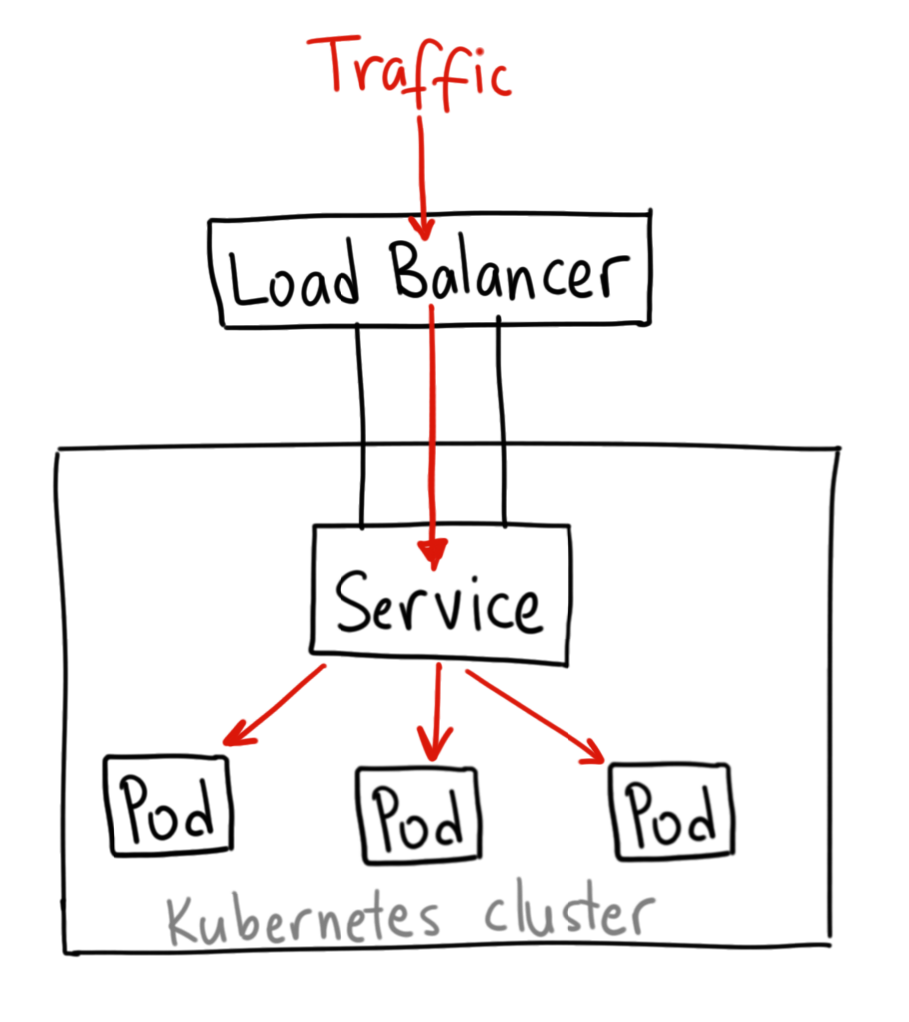
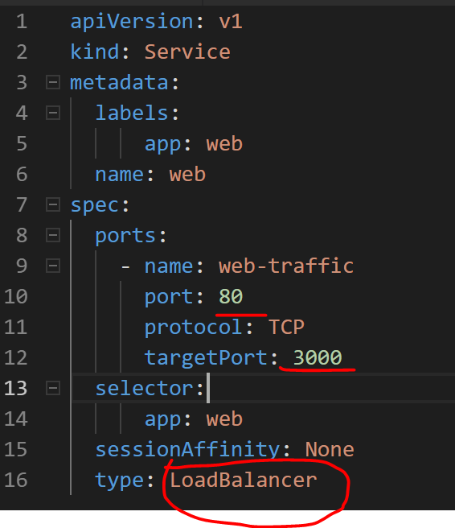
Networking – Service : Loadbalancer
How does Loadbalancer Service Works
Notes:
A LoadBalancer service is the standard way to expose a service to the internet. On AKS, uses the Azure Load Balancer that will give you a single IP address that will forward all traffic to your service.
When would you use this?
If you want to directly expose a service, this is the default method. All traffic on the port you specify will be forwarded to the service. There is no filtering, no routing, etc. This means you can send almost any kind of traffic to it, like HTTP, TCP, UDP, Websockets, gRPC, or whatever.
The big downside is that each service you expose with a LoadBalancer will get its own IP address, and you have to pay for a LoadBalancer per exposed service, which can get expensive!

Slide 71
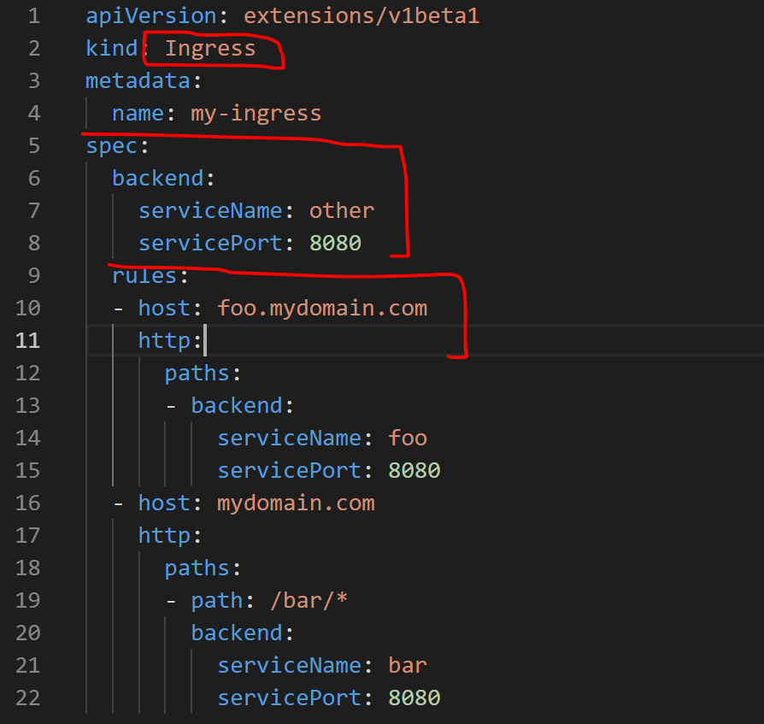
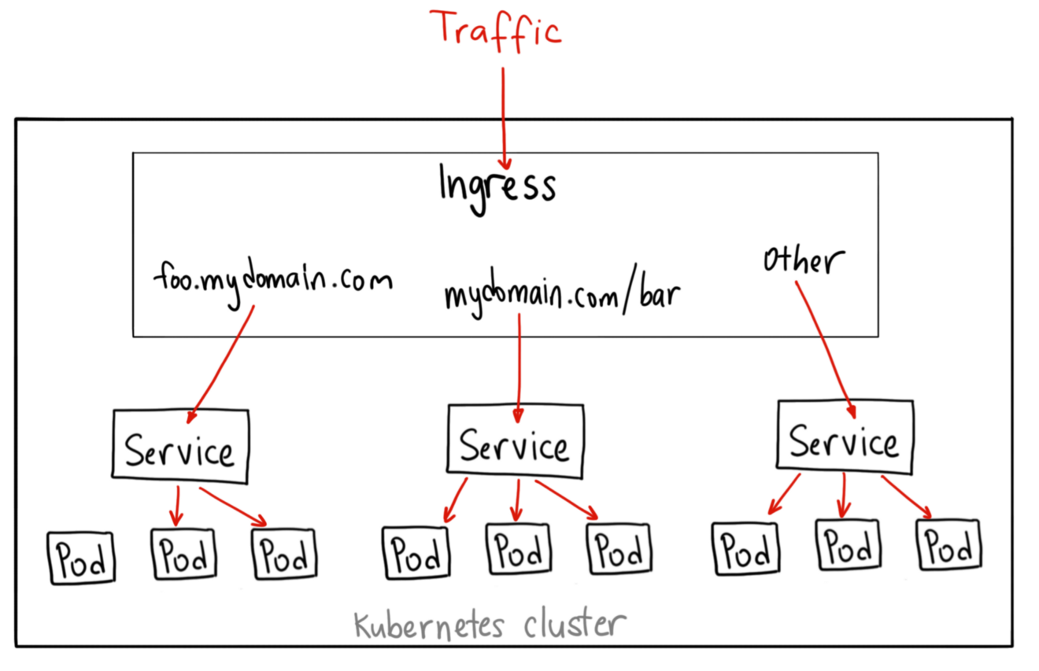
Networking – Ingress
How does Ingress Controller Works
Notes:
Unlike all the previous service examples, Ingress is actually NOT a type of service. Instead, it sits in front of multiple services and act as a “smart router” or entrypoint into your cluster.
You can do a lot of different things with an Ingress, and there are many types of Ingress controllers that have different capabilities.
When would you use this?
Ingress is probably the most powerful way to expose your services, but can also be the most complicated. There are many types of Ingress controllers, from the Google Cloud Load Balancer, Nginx, Contour, Istio, and more.
There are also plugins for Ingress controllers, like the cert-manager, that can automatically provision SSL certificates for your services.
Ingress is the most useful if you want to expose multiple services under the same IP address, and these services all use the same L7 protocol (typically HTTP). You only pay for one load balancer if you are using the native GCP integration, and because Ingress is “smart” you can get a lot of features out of the box (like SSL, Auth, Routing, etc)

Slide 72
AKS Networking
Basic (Kubenet)
Provisions its own VNET and only exposes Public IPs
Pods IPs get only cluserIPs and accessible only within the cluster
Publicly exposed services accessible outside the cluster
Max Pods per node 110
Advanced (Azure CNI)
Uses an existing VNET and expose private IPs
Pods & Services get private IPs
Max pods per node 110 (CLI / ARM, Portal - 30)
"networkPlugin": {
"type": "string",
"allowedValues": [
"azure",
"kubenet"
],
"metadata": {
"description": "Network plugin used for building Kubernetes network."
}
},
Notes:
CNCF = Cloud Native Computing Foundation
https://github.com/Azure/azure-container-networking/blob/master/docs/acs.md

Slide 73
Container Network Interface (CNI)
CNI (a CNCF project) is a spec for plugins to configure Linux container network interfaces
Wide range of support
Kubernetes, OpenShift, Cloud Foundry, Mesos, rkt, etc.
Examples
Calico, Weave, Contiv, etc.
Azure CNI plug-in integrates Azure VNET into kubernetes clusters
Notes:
CNCF = Cloud Native Computing Foundation
https://github.com/Azure/azure-container-networking/blob/master/docs/acs.md

